Slide 1
Saint Patrick’s Day

Slide 2
May your blessings outnumber
the shamrocks that grow,
and may trouble avoid you
wherever you go.
Shamrock (Holy Trinity)
Three leaf plant (faith, hope, love)
Commonly used to represent Ireland.
Four Leaf Clover
1 in 10,000
Fourth leaf represents luck

Slide 3
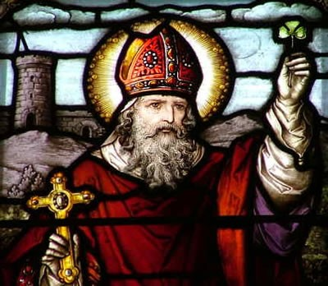
Who is Saint Patrick?
Celebrated anually on March 17th, the day St. Patrick died
Known as primary Saint of Ireland
British, but important part of Irish heritage
Brought Christianity to Ireland in fifth century

Slide 4
Why do Americans celebrate St. Patrick’s Day?
First parade: New York City, 1762 to help homesick Irish soldiers that served in British army to connect to their roots with music (bagpipes)
Pause in the Days of Lent (Ash Wednesday - Easter Sunday) to dance, drink, and eat meat
Millions of Irish people fled to America because of Great Potato Famine
Less religious outside of Ireland; display of political strength, patriotism

Slide 5
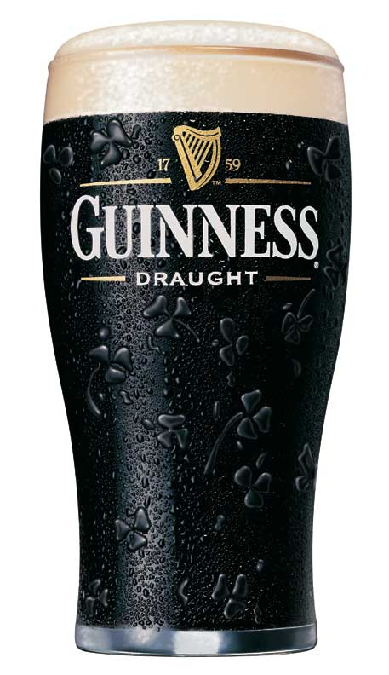
Drinking: Guinness
Because people put aside their Lent restrictions on St. Patrick’s Day, drinking has become linked as a part of this celebration
Guinness is an Irish beer that is very commonly drank on this day
On a typical day, Americans drink about 600,000 pints (280,000 liters)
On St. Patrick’s Day, Americans drink 3 million pints (1.4 million liters)

Slide 6
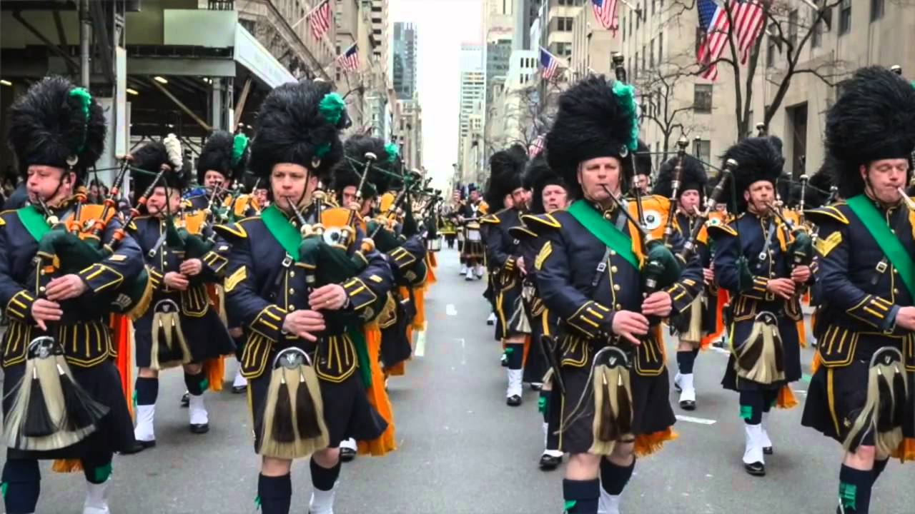
https://www.youtube.com/watch?v=ZlyHegXhjBA

Slide 7
St. Patrick’s Day in America: Facts
39% of population celebrates (122 million people)
34% make a special dinner
31% attend a party
25% decorate their home or office
8 million exchange St. Patrick’s Day cards
83% wear GREEN

Slide 8
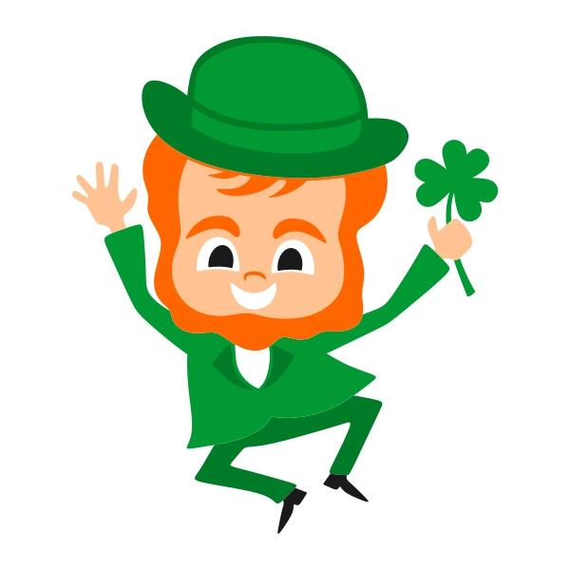
The Color Green
Ireland: “Emerald Isle,” lush landscape
Color of spring, new plants, new beginnings
Associated with Catholics in Ireland
Comes from shamrock, used to represent luck
If you don’t wear green, you get pinched by fairy creatures and leprechauns
Wearing green keeps you safe

Slide 9
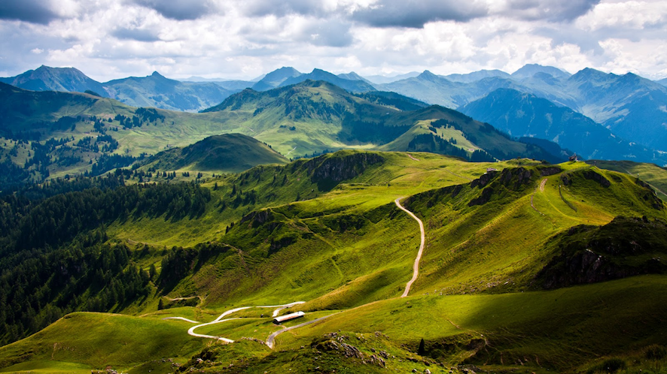

Slide 10
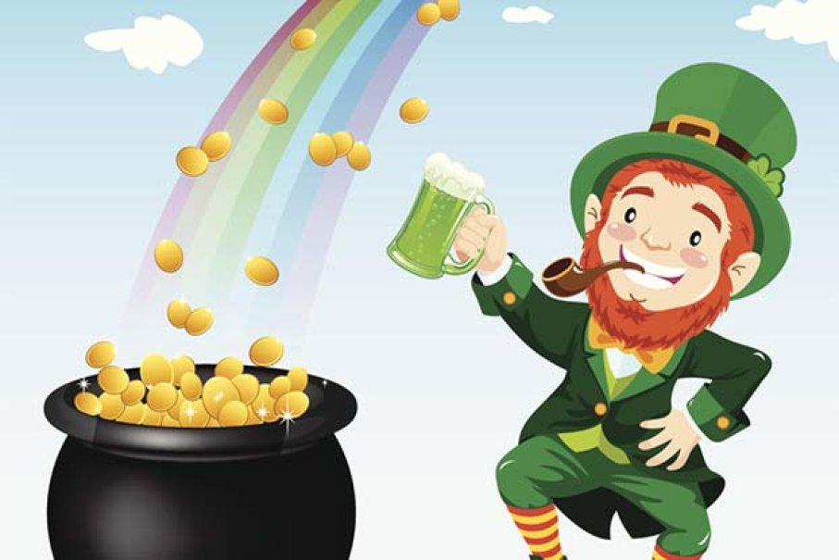
The Leprechaun
An Irish fairy, face of and old man with pointy ears that is about 2 feet tall (0,6 meters)
Spends his time looking for gold at the end of every rainbow; associated with wealth
Green helps him blend in with the grass where he hides his pot of gold
Mischievous - play pranks on people

Slide 11
The Chicago River
Chicago, Illinois
45 pounds (20,5 kg) of green vegetable dye are used to color the water of the river
Started in 1962 when mayor wanted to develop the city’s waterfront area, but the river was extremely polluted
To pinpoint the problem, the mayor authorized the pouring of a special green dye that allowed them to see and trace exactly where the dumping of waste was occuring

Slide 12
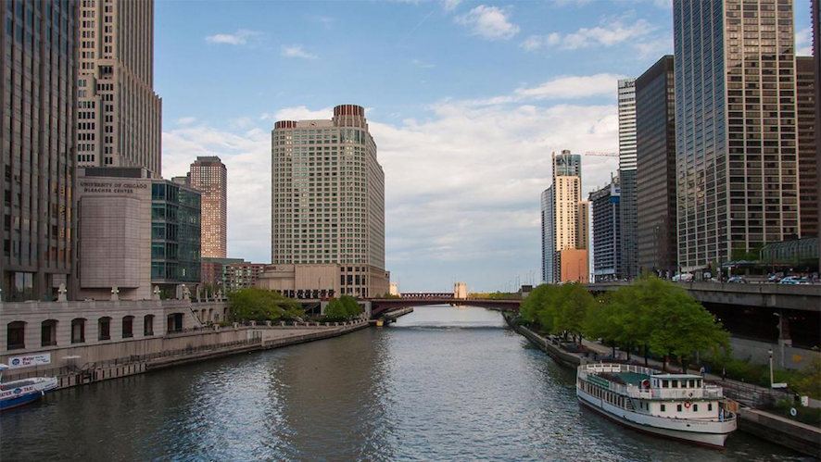

Slide 13
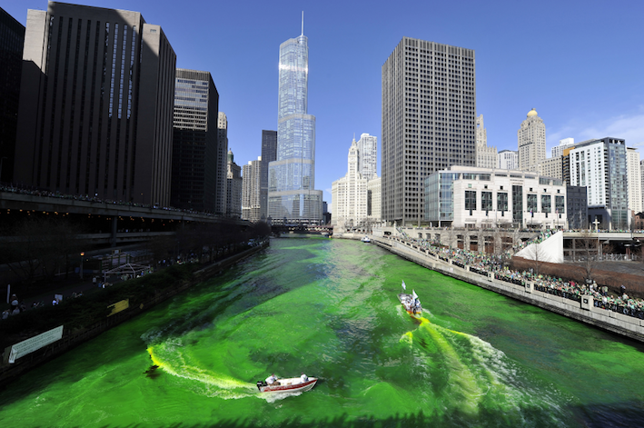
https://www.youtube.com/watch?time_continue=40&v=mdFQIVvjDH4

Slide 14
QUESTIONS
What did St. Patrick use the shamrock for?
What are blessings?
Why was St. Patrick so important for Ireland?
Define homesick.
What are the two main reasons Irish people immigrated to America?
What is Lent?
What percent of Americans wear green on St. Patrick’s Day?
Why is Ireland known as the Emerald Isle?
What does the color green represent?
Why do leprechauns wear green?
Define mischievous.
Why did the mayor of Chicago decide to dye the Chicago River green?

